Slide 1
Community health Workers, Professional Citizenship, & Advocacy
Key Topics from the CHW Movement in Indiana
Ryan I. Logan, PhD, MPH
Assistant Professor of Medical Anthropology
California State University, Stanislaus
rilogan@csustan.edu

Slide 2
Outline
Description of research & field site
01
Professional citizenship of CHWs
02
Advocacy as caregiving
03
Research with & For CHWs
04

Slide 3
The Field Site & Research Context
CHWs, Indiana, Research Methods, & the State of Health

Slide 4
Summarizing Potential impacts of CHW Integration in Indiana
“For Indiana especially, the shortage of healthcare workers is beginning to be a challenge…[there’s] gotta be an entry into it [the healthcare workforce] because not everyone is going to be an RN or a phlebotomist but they could be that health educator or member of a healthcare team that follows as a patient that helps keep them from relapsing or being admitted to a hospital because they didn’t know how to manage their chronic condition.
That’s where I see a great importance for CHWs, to be that educator where the doctor or nurse doesn’t have the time to do that. . . . They [medical professionals] cannot hand-hold, but the CHW could possibly help that individual. The CHW could focus on the individual client and help them not go back into the system.”
Martha, CHW

Slide 5
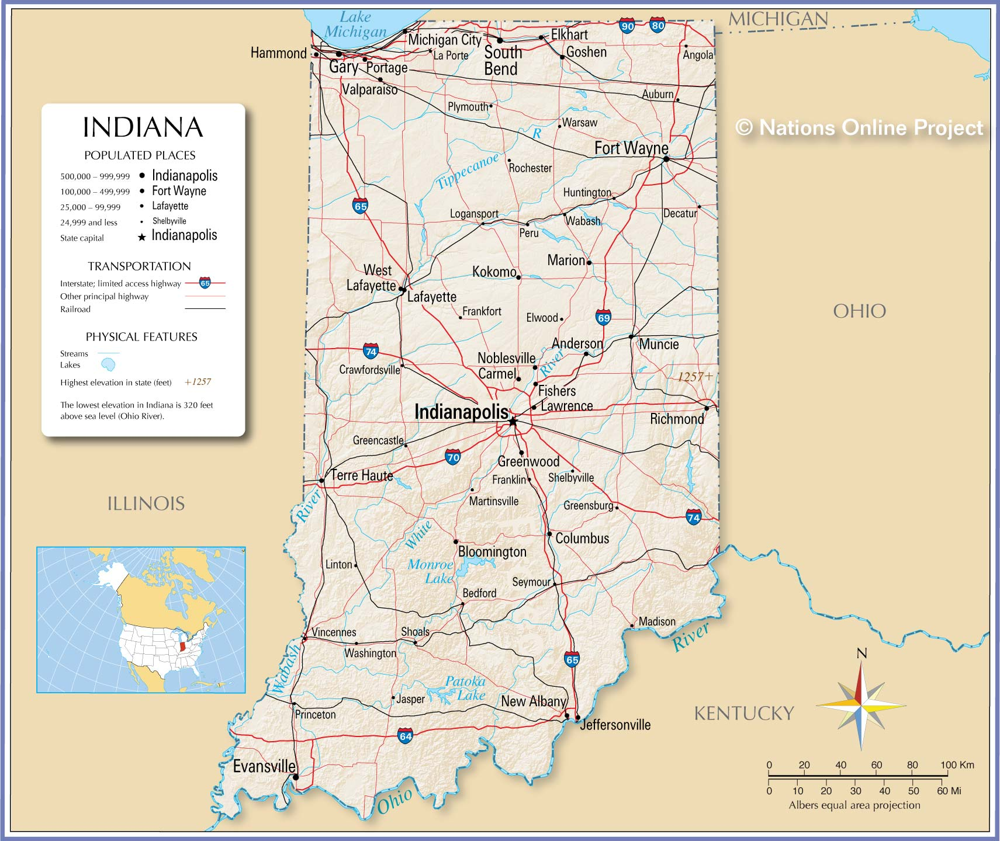

Slide 6
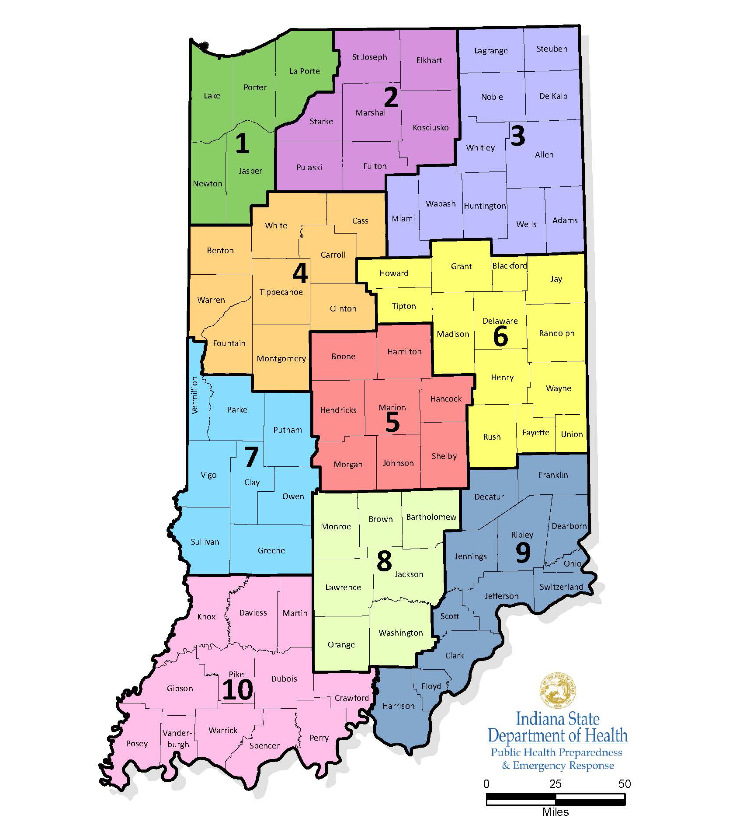
Indiana Community Health Workers Association (INCHWA)
Incorporated in 2015
Led by a president (a CHW), supported by a board of directors
Based in central Indiana but serves CHWs in the state as a whole
Houses the CHW certification
Conducts increasing amounts of research with universities to enhance the CHW workforce
Conducts monthly Zoom sessions, workshops, guest speakers, etc.

Slide 7
Health & Social Issues in Indiana
Hostile political climate for migrants, populations of color, LGBTQ+
Currently ranked 35/50 (America’s Health Rankings 2023)
Had ranked at 41/50 during data collection
Specific health issues CHWs could address (America’s Health Rankings 2023):
Diabetes (36)
Obesity (38)
Smoking (41)
Preventable hospitalizations (37)
Infant mortality (40)
Public health funding ($76 per capita, 45)

Slide 8
What is a Community health worker (CHW)?
“A community health worker is a frontline public health worker who is a trusted member of and/or has an unusually close understanding of the community served. This trusting relationship enables the worker to serve as a liaison/link/intermediary between health/social services and the community to facilitate access to services and improve the quality and cultural competence of service delivery.
A community health worker also builds individual and community capacity by increasing health knowledge and self-sufficiency through a range of activities such as outreach, community education, informal counseling, social support and advocacy.”
CHW Section of the American Public Health Association (2023) [emphasis added]

Slide 9
HealthCare Team & Social Determinants of Health
Healthcare Team
Social Determinants of Health
Medical doctors
Physician associates
Nurses
Dentists
Social workers
Pharmacists
+ CHWs [officially]?
Some examples:
Access to (healthy) food, health care, safe spaces
Transportation
Finances
Health insurance
Health education

Slide 10
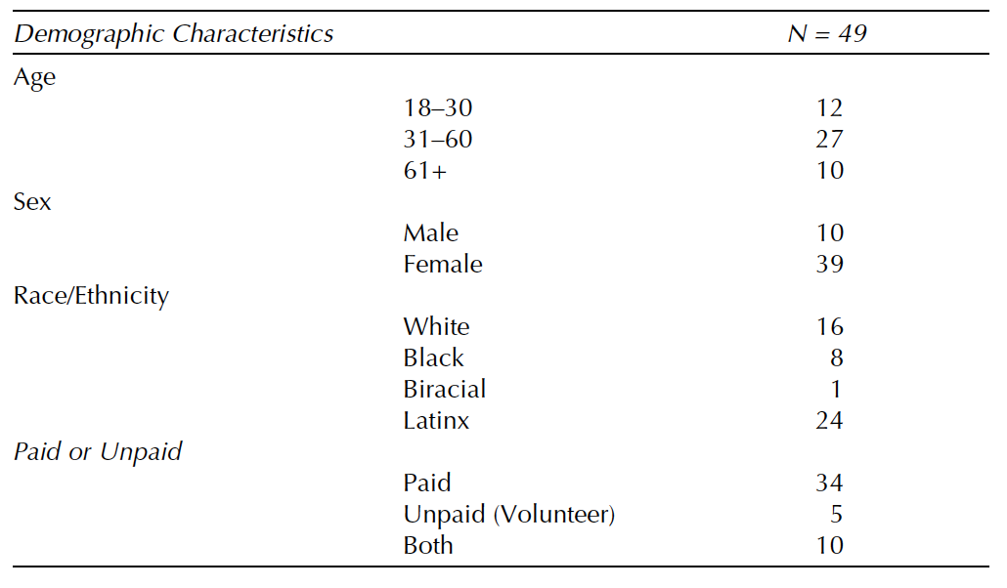
Methods & Location
Data collection:
Long-term engagement 2016 to 2018
Follow-up research 2019-2023
Location:
Indiana
Methods
Semi-structured interviews (n=49)
Participant observation (n>300 hours)
Photovoice
Collaborative approach
Table source: Logan, Ryan I. 2022. Boundaries of Care: Community Health Workers in the United States. Lanham, MD: Lexington Books.

Slide 11
Professional Citizenship
Theoretical Framing

Slide 12
Theoretical Framing: Medical Citizenship
Medical citizenship: “how membership in a state, a society, or even humanity itself is mediated by prevailing regimes of health-related power and knowledge” (Good et al. 2010, 177)
Essentially being denied access to care, resources – thus lacking belonging (i.e., citizenship)
See also Nichter 2008; Wailoo, Livingston, and Guarnaccia 2006

Slide 13
Theoretical Framing: Professional Citizenship
Professional Citizenship
Legitimizing Mechanisms
“the belongingness or legitimacy of a group within a professional workforce”
“facilitate belongingness and/or foster legitimacy”
Source: Logan, Ryan I. 2021. “Professionalization as a ‘Double-Edged Sword’: Assessing the Professional Citizenship of CHWs in the Midwest.” Human Organization 80, no. 3: 192-202.

Slide 14
Three Legitimizing Mechanisms (in Indiana)
Certification
Name branding
Medicaid Reimbursement

Slide 15
1.) Certification
Potentials
Ramifications
Serves almost as a degree
Add legitimacy to CHW skillset
Wider acceptance especially in healthcare workforce
Exclusionary?
$1,500 tuition
70-hour time commitment
CHW hierarchy?

Slide 16
2.) Name branding
Potentials
Ramifications
More recognition
Consistency
Necessary to qualify for Medicaid reimbursement
Adequately capturing scope of the work
Lack of flexibility in titling could restrict positions

Slide 17
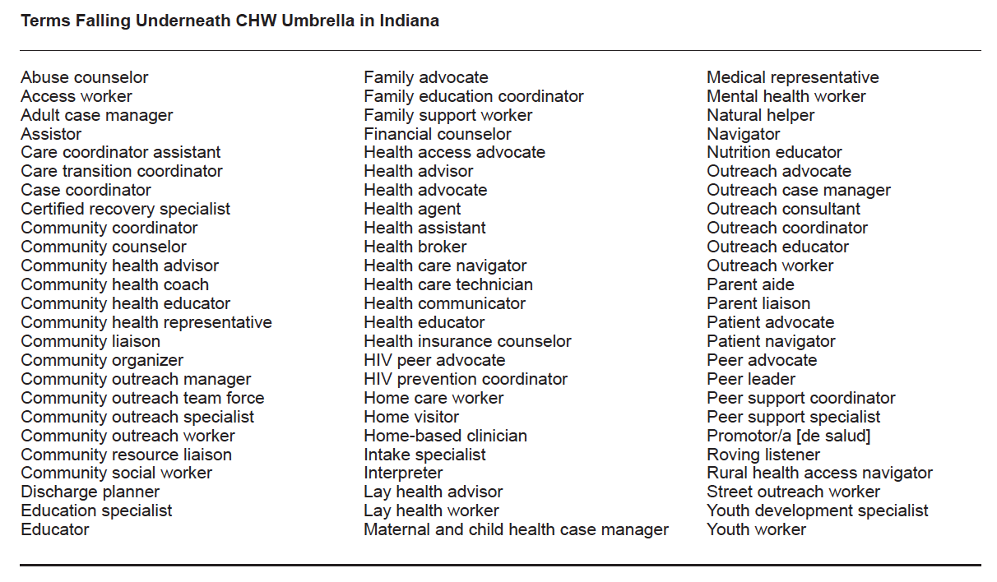
Table source: Logan, Ryan I. 2021. “Professionalization as a ‘Double-Edged Sword’: Assessing the Professional Citizenship of CHWs in the Midwest.” Human Organization 80, no. 3: 192-202.

Slide 18
Implications of the Term “Community health worker”
I don’t think it’s the best term [community health worker]. Don’t ask me what is the best term [laughter], because it just depends.
But I think there is too much health in it . . . and the danger of the term is that it’s too medicalized.
And we know that medical is just a tiny little bit of the person’s health. It almost is, “Well, that’s the consequence of everything else that is going on” so we’re now calling it [the CHW position] the consequence.
Lucía, CHW

Slide 19
3.) Medicaid Reimbursement
Potentials
Ramifications
Incentivize hiring of CHWs
Send workers to certification course, or grandfather
Also addresses title issue
CHW-specific services
Services strictly medical focused
Risk overmedicalizing the position
Advocacy, time spent addressing SDoH not currently reimbursed

Slide 20
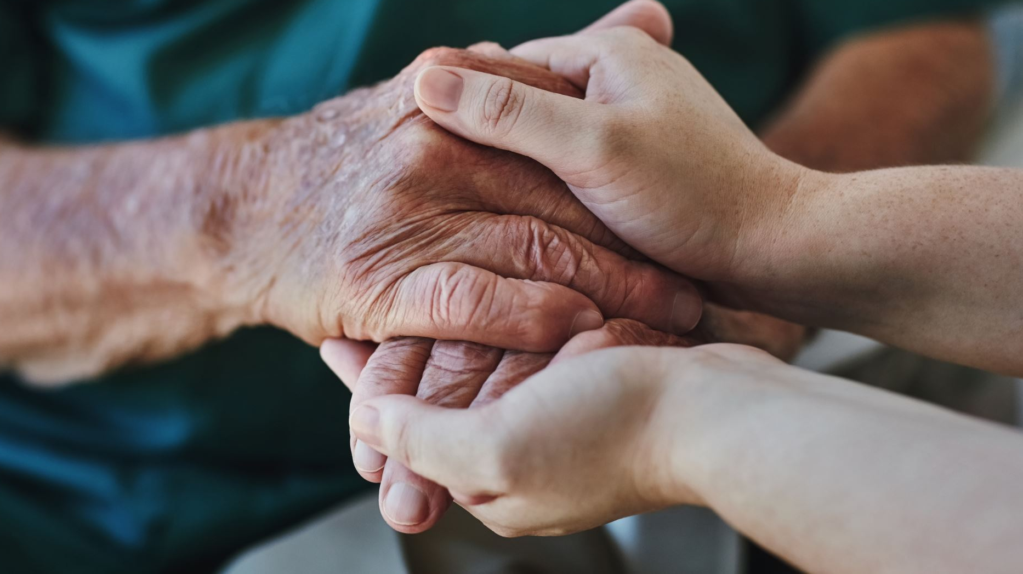
Advocacy as Caregiving

Slide 21
Levels of Advocacy & Advocacy as Caregiving
Micro-level advocacy: impacts individual clients, changes organizational policy
Speaking up for a client, getting an organization to have multiple language forms
Macro-level advocacy: impacts at the community, societal level
Organizing health fairs, community events; working with politicians, organizing town halls
Professional-level advocacy: impacts in the professional workforce
CHW advocating to other professionals (or their own employers) regarding their legitimacy of the CHW position
Advocacy served in and of itself as a form of caregiving
Source: Logan, Ryan I. 2019. Being a Community Health Worker Means Advocating: Participation, Perceptions, and Challenges in Advocacy. Anthropology in Action 26, no. 2: 9-18. Building from the work of Sabo et al. 2013. Predictors and a Framework for Fostering Community Advocacy as a Community Health Worker Core Function to Eliminate Health Disparities. American Journal of Public Health 103, no. 7: e67-e73.

Slide 22
Addressing SDoH through Advocacy
Barriers to care (e.g., financial, language, legal status)
Health disparities
SDoH
(Lack of) Transportation
Food insecurity
Mapping out bus routes, bus passes, transporting clients
Connecting to food pantry, applying for food stamps for clients
Connecting to services, attending appointments
Advocacy
Building health equity

Slide 23
Research with & For CHWs
Steps Forward

Slide 24
Roles for Social Scientists & CHWs
Assess context, potential, and ramifications of professionalization of other paraprofessionals
Collaborative research
Photovoice, other visual data collection methods
Rapid ethnographic research
To help inform policy, get data back faster
Co-publish with participants – policy briefs

Slide 25
Involving CHWs
Roles:
Include CHWs in the design, process, and analysis
CHWs as co-researchers, data collectors
Sources:
Maes et al. (2014)
C3 Project (2018)
CHW Section of APHA (2023)
Growing calls CHW inclusion in research
Leverage connections, knowledge of CHWs

Slide 26
Thank you

Slide 27
References
American Public Health Association. 2023. Community Health Workers. Retrieved from: https://www.apha.org/apha-communities/member-sections/community-health-workers
Community Health Worker Core Consensus Project (C3). 2018. “Together Leaning Toward the Sky.” Retrieved from: . https://0d6c00fe-eae1-492b -8e7d-80acecb5a3c8.filesusr.com/ugd/7ec4232b0893bcc93a422396c744b e8c1d54d1.pdf
Good et al. 2010. A Reader in Medical Anthropology: Theoretical Trajectories, Emergent Realities. Malden: Wiley-Blackwell Publishing.
Logan, Ryan I. 2021. “Professionalization as a ‘Double-Edged Sword’: Assessing the Professional Citizenship of Community Health Workers in the Midwest.” Human Organization 80, no. 3: 192-202.
Logan, Ryan I. 2022. Boundaries of Care: Community Health Workers in the United States. Lanham: Lexington Books.
Maes et al. 2014. “Listening to Community Health Workers: How Ethnographic Research Can Inform Positive Relationships Among Community Health Workers, Health Institutions, and Communities.” American Journal of Public Health 104, no. 5 (2014): e5–e9.
Nichter, Mark. 2008. Global Health: Why Cultural Perceptions, Social Representations, and Biopolitics Matter. Tucson: University of Arizona Press.
Wailoo et al.. 2006. A Death Retold: Jessica Santillan, the Bungled Transplant, and Paradoxes of Medical Citizenship. Chapel Hill: The University of North Carolina Press.

Slide 28
Questions? rilogan@csustan.edu

