Slide 1
The End of the Continuous Enrollment Condition: What Partners Need to Know About Medicaid and CHIP Coverage
May 2023
Notes:
Talking Points for This Slide:
Good morning/afternoon everyone. My name is [insert name] and I am a [insert title] at [insert agency/department]. It is a pleasure to join you today to speak a little about the end of the Medicaid Continuous Enrollment Condition and what that means for people enrolled in Medicaid and Children's Health Insurance Program (CHIP) as we return to normal operations.
Since March 2020, as a condition of receiving an increased federal matching rate, states have been required to maintain enrollment of nearly all Medicaid enrollees. Now that the continuous coverage requirement has expired, states will have up to 12 months to return to normal eligibility and enrollment operations, including disenrolling ineligible individuals. This process has commonly been referred to as “unwinding”.
Under the Consolidated Appropriations Act, 2023, expiration of the continuous enrollment condition and receipt of the temporary FMAP increase are no longer linked to the end of the Public Health Emergency (PHE). The continuous enrollment condition ended on March 31, 2023. As of April 1, 2023, states are able to terminate Medicaid enrollment for individuals no longer eligible. The public health emergency will end later (in May 2023).
We, at HHS and CMS, are dedicated to making sure that people stay connected to coverage, whether that is remaining on Medicaid or CHIP if they are still eligible or transitioning to another coverage option, such as Marketplace coverage.
Since many people enrolled in Medicaid and CHIP have not had to complete a full renewal process in nearly three years (if ever), we want to make sure that people enrolled in Medicaid and CHIP are aware that this is coming and to make sure their state agency has their updated contact information so they can be reached when their state begins reaching out to beneficiaries.

Slide 2
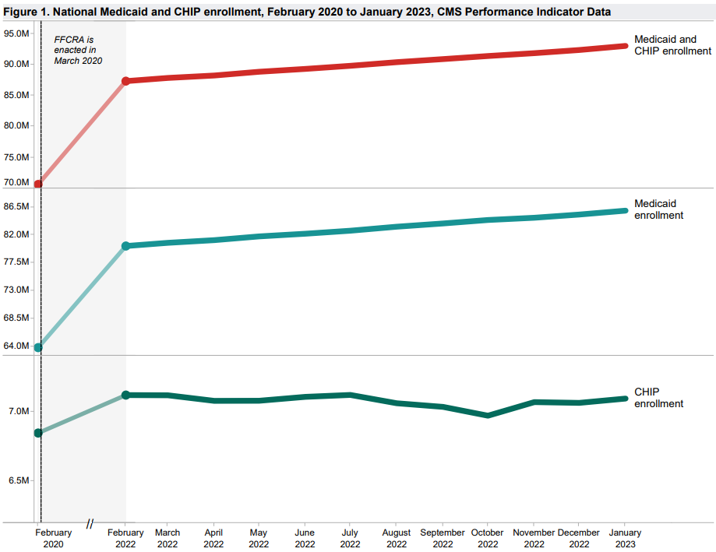
Medicaid & CHIP Today: Enrollment Is at an All-Time High
In March 2020, the Families First Coronavirus Response Act (FFCRA) established the continuous enrollment condition, which gave states extra federal Medicaid funding in exchange for maintaining enrollment for most individuals.
As a result of this legislation and flexibilities adopted by states, Medicaid and Children’s Health Insurance Program (CHIP) enrollment has grown to a record high.
Over 93 million individuals were enrolled in health coverage through Medicaid and CHIP as of January 2023.
This represents an increase of over 22 million individuals, or nearly 32 percent, since February 2020.
https://www.medicaid.gov/medicaid/national-medicaid-chip-program-information/downloads/january-2023-medicaid-chip-enrollment-trend-snapshot.pdf
Notes:
Talking Points for This Slide:
Medicaid and CHIP have been a lifeline for health coverage for millions of people during the pandemic. Due, in part, to legislation that incentivized coverage continuity and flexibilities that states adopted, enrollment in both programs is at an all-time high
Medicaid and CHIP enrollment is at an all-time high right now. There are over 93 million people who are enrolled in Medicaid and CHIP as of January 2023. A lot of that is due to the continuous enrollment condition. The continuous enrollment condition describes a policy that came out of the Families First Coronavirus Response Act (FFCRA), which was federal legislation back in March 2020, that gave states increased Medicaid funding in exchange for keeping nearly everyone enrolled in Medicaid.
Since March 2020, the majority of individuals who were enrolled and who subsequently enrolled in Medicaid have been continuously enrolled in the program. In the Children's Health Insurance Program, states have adopted some similar flexibilities that have resulted in the same effect, increasing enrollment, which is how we are where we are now at over 93 million people enrolled. That is an increase of nearly 32 percent or 22 million individuals since February 2020.

Slide 3
Ending the COVID-19 Continuous Enrollment Condition
Under the Consolidated Appropriations Act 2023 (CAA, 2023), enacted in December 2022, the FFCRA Medicaid continuous enrollment condition ended on March 31, 2023.
States will resume normal operations, including restarting full Medicaid and CHIP eligibility renewals and terminations of coverage for individuals who are no longer eligible.
States are able to terminate Medicaid enrollment for individuals no longer eligible as of April 1, 2023.
States will need to address a significant volume of pending renewals and other actions. This is likely to place a heavy burden on the state workforce and existing processes.
As states resume full renewals, over 15 million people could lose their current Medicaid or CHIP coverage.¹ Many people will then be eligible for coverage through the Marketplace or other health coverage and need to transition.
On January 30, 2023, the Biden-Harris Administration announced its intent to end the national emergency and PHE declarations related to the COVID-19 pandemic on May 11, 2023.
¹Available at: https://aspe.hhs.gov/reports/unwinding-medicaid-continuous-enrollment-provision
Notes:
Talking Points for This Slide:
The continuous enrollment condition ended on March 31st. The Omnibus bill, also known as the Consolidated Appropriations Act or CAA, 2023 that passed and was enacted in December 2022 , said that the FFCRA continuous enrollment condition will end on March 31, 2023.
With the end of the continuous enrollment condition, states will now begin the process of “unwinding” - or returning to normal Medicaid/CHIP operations. That includes restarting full Medicaid and CHIP eligibility renewals and for Medicaid, disenrolling individuals who are no longer eligible.
Because the continuous enrollment condition ended on March 31, states are now able to terminate Medicaid enrollment for individuals they identify as no longer eligible as of April 1 of 2023.
This work will require a significant amount of work on the states’ part. Researchers have estimated that nearly 15 million enrollees could lose their Medicaid or CHIP coverage as states resume normal renewals and redetermination processes.
However, it is important to note that these estimates do not represent the number of people who are likely to become uninsured. A central goal for unwinding is to ensure that people who remain eligible for Medicaid and CHIP can retain their coverage, and those who are not are able transition to other affordable coverage options, through the Marketplace, Medicare, employer-sponsored coverage, or other insurance.
Additional Talking Points:
As noted previously, the Medicaid continuous enrollment condition is no longer linked to the end of the COVID-19 Public Health Emergency.
On January 30, 2023, the Biden Administration announced its intent to end the national emergency and public health emergency declarations on May 11, 2023, related to the COVID-19 pandemic.
Again, the COVID-19 Public Health Emergency is now separate from the ending of the Medicaid continuous enrollment condition, which is the focus of today’s presentation.

Slide 4
Resuming Normal Eligibility and Enrollment Operations: Expectations of States
Now that the continuous enrollment condition has ended, states must initiate eligibility renewals for the state’s entire Medicaid and CHIP population within 12 months and complete renewals within 14 months.
States could begin this process in February, March, or April 2023 but could not terminate eligibility for most individuals in Medicaid prior to April 1, 2023.
States have 4 months to resume timely processing of all applications, including those received after April 1, 2023.
The Centers for Medicare & Medicaid Services (CMS) has been working closely with states for over a year to ensure that they are ready; that eligible enrollees retain coverage by renewing their Medicaid or CHIP; and that enrollees eligible for other sources of coverage, including through the Marketplace, smoothly transition.
CMS has also issued an array of guidance and tools to support state processing of eligibility and enrollment actions, including new flexibilities and requirements for states.
Notes:
Talking Points for This Slide:
What are states expected to do?
In returning to normal operations, states are expected to initiate eligibility renewals for everyone in their Medicaid and CHIP populations within 12 months, starting in February, March or April 2023. They will have an additional 2 months, so 14 months total, to finish processing the renewals they initiate.
As I noted, states have 3 options for when to begin redeterminations that may result in disenrollments for Medicaid enrollees - in February, March, or April 2023. Regardless of when they started, though, states could not terminate eligibility for individuals in Medicaid before the continuous enrollment condition ended on March 31.
Separately, CMS has provided extensive guidance to states about other expectations during this unwinding period. States have four months to resume timely processing of applications to the extent that that has not been the case during this period when the continuous enrollment condition has been in effect.
States have also been preparing for this process for over a year now, to ensure that eligible individuals can retain coverage and to make sure people who are eligible for other programs transition effectively.
The Department of Health and Human Services shares this goal, and we are committed to working with states, governors, and others to provide resources, tool, and guidance to ensure a successful unwinding period.

Slide 5
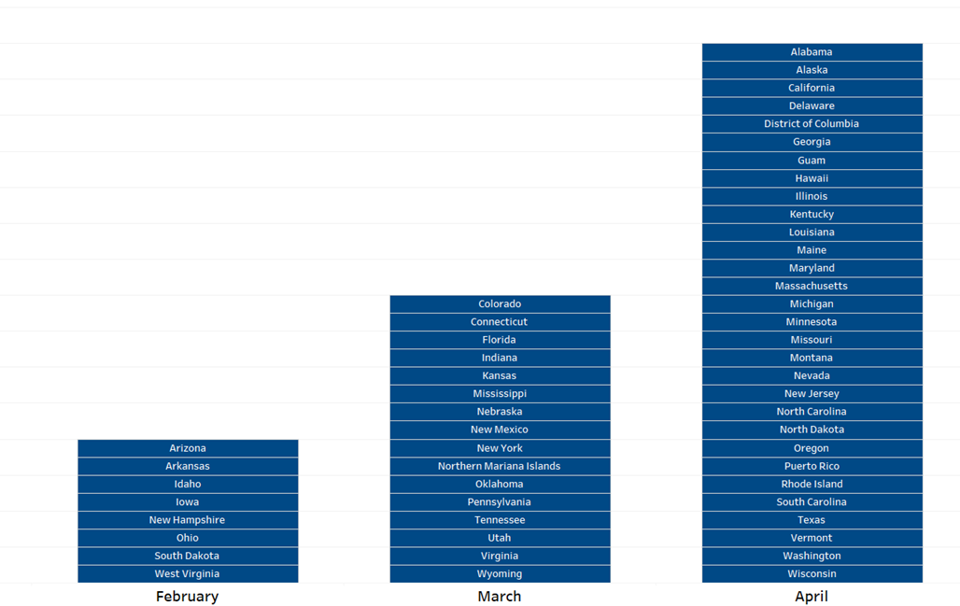
First Unwinding-Related Renewals Initiated, by Month
Based on state assessment calls conducted or deliverables submitted (55) as of 2/24/23; data and visuals in these slides are preliminary.
Data regarding USVI not included.
Notes:
Talking Points for This Slide:
This graph here displays when the first Unwinding-related renewals were initiated by month. You can see which states initiated their first Unwinding-related renewals each month. To note, this information is based on state assessment calls conducted or deliverables submitted as of February 24, 2023. Timelines may have shifted since then.
This information can also be in chart form on Medicaid.gov/renewals.
Link to anticipated timelines document: https://www.medicaid.gov/resources-for-states/downloads/ant-2023-time-init-unwin-reltd-ren-02242023.pdf

Slide 6
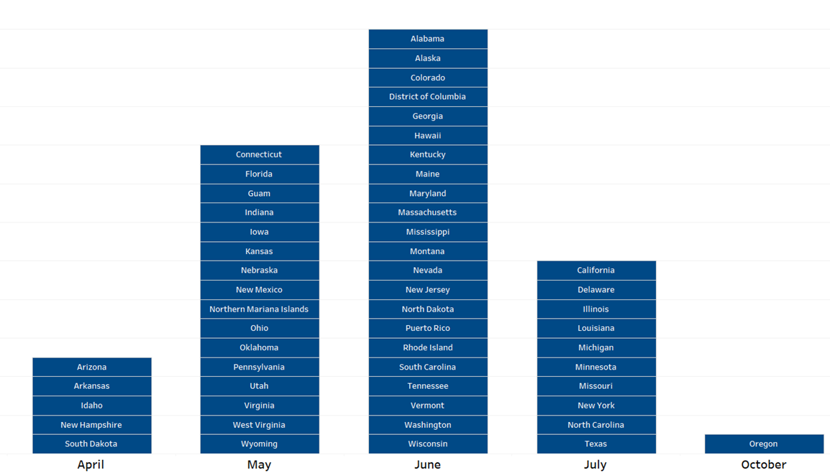
Effective Date of First Anticipated Terminations, by Month
Based on state assessment calls conducted or deliverables submitted (55) as of 2/24/23; data and visuals in these slides are preliminary.
Data regarding USVI not included.
Notes:
Talking Points for This Slide:
This graph here displays the effective date of first anticipated terminations by month. Similar to the previous slide, this information is based on state assessment calls conducted or deliverables submitted as of February 24, 2023. Timelines may have shifted since then.
This information can also be in chart form on Medicaid.gov/renewals.
Link to anticipated timelines document: https://www.medicaid.gov/resources-for-states/downloads/ant-2023-time-init-unwin-reltd-ren-02242023.pdf

Slide 7
The Renewal Process
States must renew eligibility only once every 12 months for MAGI beneficiaries (most kids, adults, pregnant individuals, etc.) and at least once every 12 months for non-MAGI beneficiaries (e.g. aged, blind, disabled individuals).
States must begin the renewal process by first attempting to redetermine eligibility based on reliable information available to the agency without requiring information from the individual (ex parte renewal, also known as auto renewal, passive renewal, or administrative renewal).
If available information is sufficient to determine continued eligibility, the state renews eligibility and sends a notice.
If available information is insufficient to determine continued eligibility, state sends a renewal form and requests additional information from the beneficiary.
For MAGI Medicaid, CHIP, and BHP, states must provide the individual at least 30 days to return the form. For Non-MAGI coverage, states must provide a reasonable time frame
If the Medicaid agency determines that an individual is ineligible for Medicaid, the state determines potential eligibility for other coverage like the Marketplace, and transfers the individual’s account information to the Marketplace for a determination.
Notes:
Talking Points for This Slide:
I just talked about general timelines for initiating renewals, but it’s important to remember what the renewal process entails.
Generally, states need to renew eligibility for everyone in their Medicaid and CHIP programs once every 12 months for MAGI beneficiaries. When I say MAGI, I refer to populations enrolled based on modified, adjusted gross income, including most children, parents, pregnant individuals, and other non-disabled.
States must renew eligibility at least once every 12 months for non-MAGI beneficiaries. These include individuals who are over 65, as well as those with blindness or disabilities.
States must first attempt to renew eligibility for appropriate populations based on information available to the state, without asking for documentation. That is referred to as an ex-parte renewal, also called auto-renewal, passive renewal, or administrative renewal.
If someone can be redetermined eligible based on available information, the state must send a notice letting them know that they are still eligible and requesting any corrections or updates, if needed.
If a state attempts an ex parte renewal and cannot find a person eligible that way, the state must send a renewal form to request needed information.
For individuals enrolled on a MAGI basis (most children and non-disabled adults), the state must provide a minimum of 30 days to return the form.
Lastly, if the Medicaid agency determines an individual is ineligible for Medicaid, it must screen them for eligibility for other programs and transfer their information to the appropriate program. Many children may be transferred to CHIP. Individuals may also be transferred to the Marketplace for a determination.

Slide 8
Preparing for the Work Ahead
Most states have been actively preparing for the end of the continuous enrollment condition for over a year. CMS has encouraged all states to:
Develop an unwinding plan to prioritize and distribute renewals
Obtain updated contact information to ensure that individuals receive information on redeterminations.
Launch a robust outreach and communication plan for beneficiaries and stakeholders
Engage community partners, health plans, and the provider community to amplify key messages and to provide assistance with renewals
However, there are anticipated challenges to overcome:
Large volume of renewals for states to complete
Workforce challenges and staffing shortages experienced by state Medicaid and CHIP agencies
The long length of time since many enrollees have had to complete a renewal
The likelihood of outdated mailing addresses and other contact information for enrollees
Multiple resources are available to support both states and partners in this effort.
Notes:
Talking Points for This Slide:
States have been preparing for the end of the continuous enrollment condition for over a year now and have done a number of things to be ready, including:
Developing detailed unwinding plans
Obtaining updated contact information
Launching outreach and communications plans, and
Engaging a broad range of partners to support renewals and enrollees.
We all recognize, though, that there is much work ahead and challenges that state agencies will be working to overcome as this work progresses:
As noted at the start, there is a large volume of renewals for states to complete, given that enrollment is at an all-time high
Workforce shortages make completing the work timely much more difficult
Given how long it has been since many individuals have had contact with the Medicaid agency, contact information may also be outdated. That makes efforts to update contact information especially important.

Slide 9
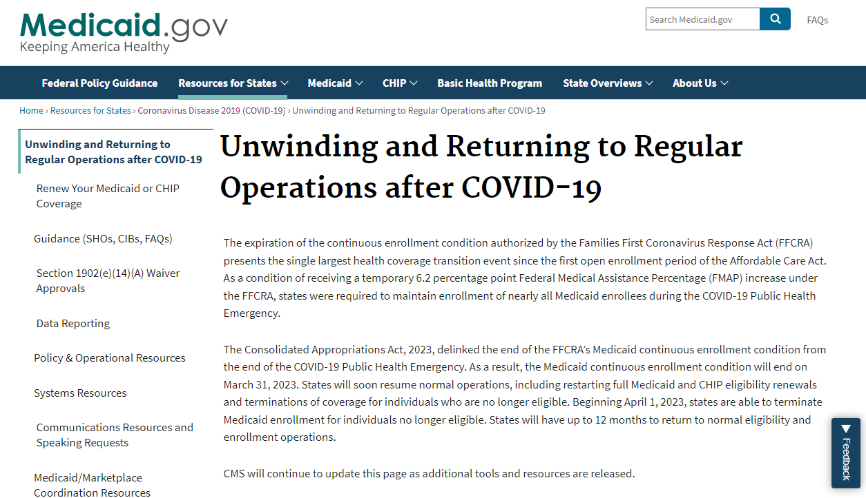
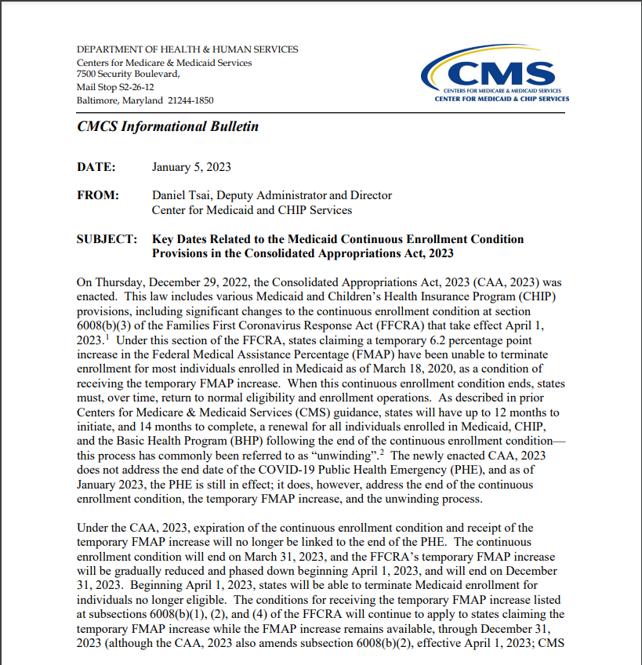
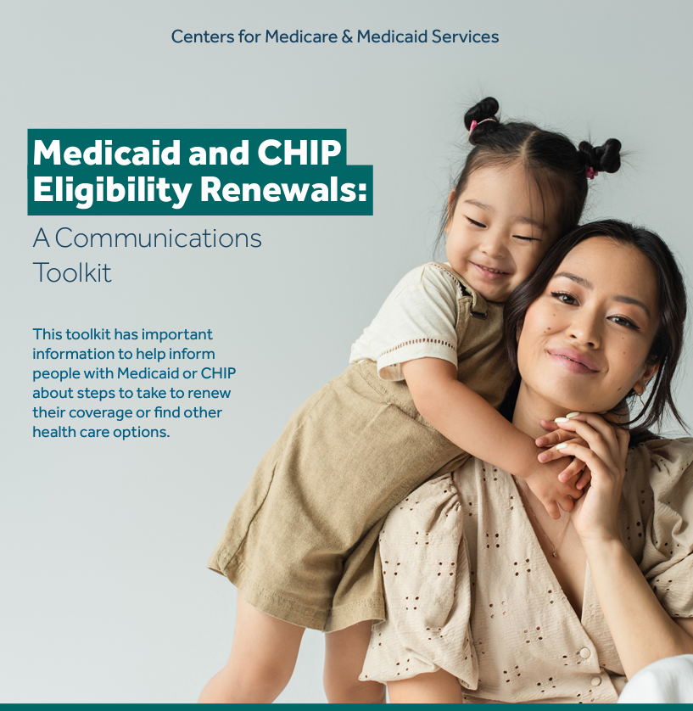
Medicaid.gov/Unwinding: Resource Page for States and Partners
Notes:
Talking Points for This Slide:
We, at HHS, have also been focused on providing the tools and resources needed to ensure a successful unwinding period. We have adopted an all-of-government approach, working closely with states, stakeholders like you, and government partners to support the work ahead.
There are two pages that, if you aren't aware of, are good for you to visit. The first one is Medicaid.gov/unwinding, which is a page that includes lots of resources for states and partners to support the work on unwinding.

Slide 10
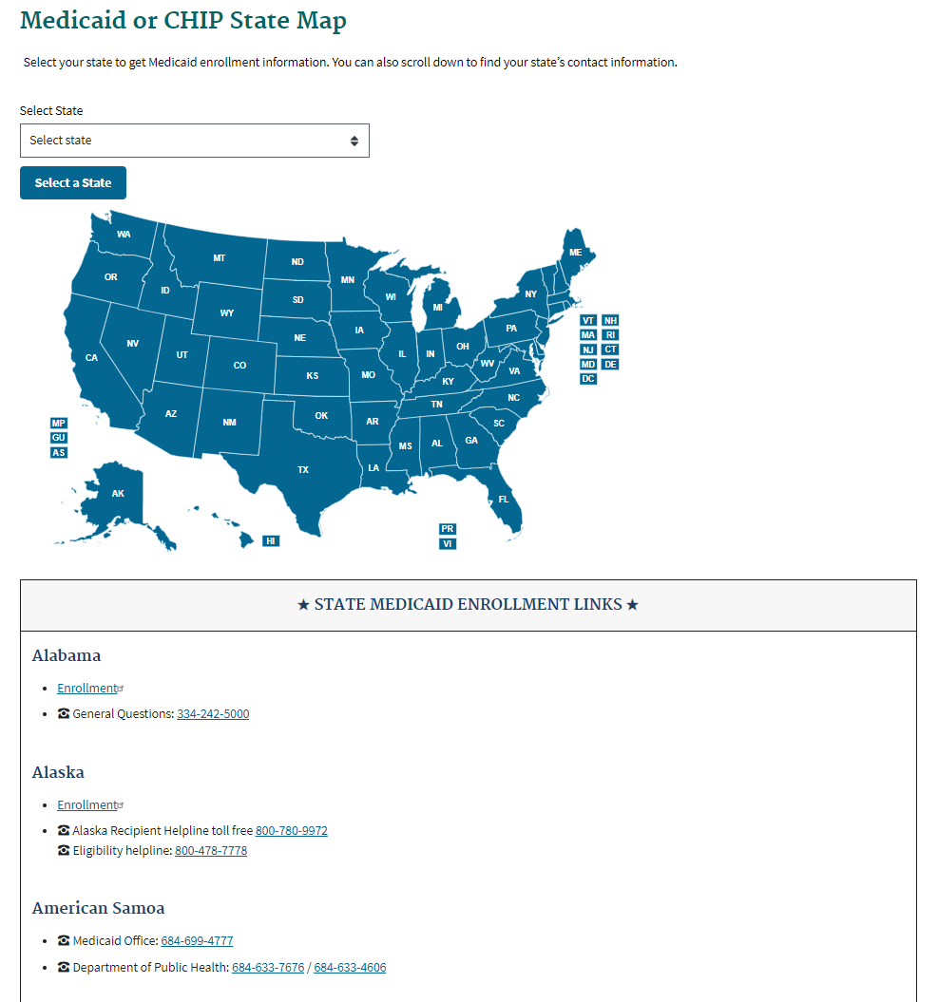
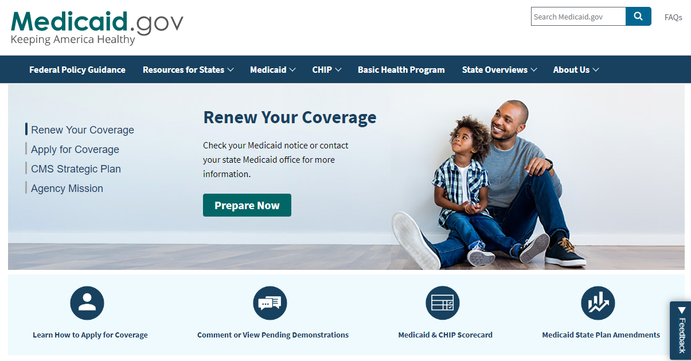
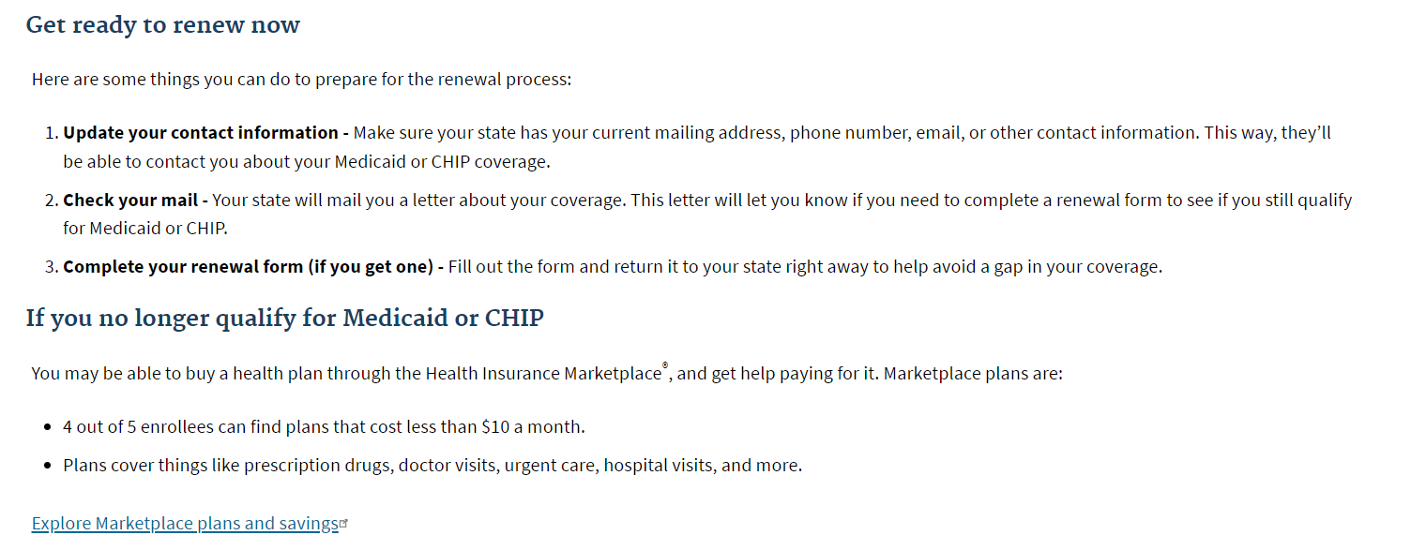
Medicaid.gov/Renewals: Resources for Medicaid and CHIP Enrollees
Notes:
Talking Points for This Slide:
In May 2022, CMS also launched a consumer-facing page (Medicaid.gov/renewals) for individuals in Medicaid and CHIP to learn about unwinding, get connected to their state agency, and find help. Medicaid/CHIP beneficiaries, providers, and community partners can visit the page, select their state, and be directed to state resources.
Lastly, we have Medicaid.gov/renewals. This is a page that is really consumer-facing is how we think about it. It is a page that allows individuals to click on their state on the map or in one of the links below the map and give them information about where they can go to update their contact information. Also provides some basic information targeted toward individuals with Medicaid and CHIP to help them understand the process.
Both of these pages are continually being updated with new resources and new information.

Slide 11
Communications Strategy
Campaign Goal
Ensure individuals maintain coverage through renewal, or become enrolled in the source of coverage for which they are eligible, whether through Medicaid, CHIP, Basic Health Program or the Marketplace
Strategic Approach
Multi-pronged, whole of government communications approach, in partnership with the states and stakeholders, to ensure people with Medicaid are aware of the steps they need to take to maintain coverage
Create a national outreach campaign that builds on states’ efforts and engages deeply with partners and stakeholders
Timeline
Phase I: Get Ready and Awareness
Timeline: Underway and refreshed on February 1, 2023
Phase II: Medicaid Re-determination and Retaining Coverage
Timeline: April 1, 2023 until the end of the Unwinding period
Notes:
Talking Points for This Slide:
We are dedicated to making sure that people stay connected to coverage, whether that is remaining on Medicaid or CHIP if they are still eligible or transitioning to another coverage option, such as Marketplace coverage.
Through a multi-pronged, whole-of-government communications approach, we’re working to create a national outreach campaign that builds on states’ efforts and engages deeply with partners and stakeholders.
There are two phases to our current approach.
We are now in Phase 2. However, Phase 1 messages are still relevant in Phase 2. Phase 1 focuses on awareness, so that people with Medicaid and those who support them know that this eligibility renewal is coming in the future, and that they need to pay attention, ensure their contact information is up to date, watch their mail, and take action if necessary.
Outreach was refreshed on April 1, 2023 since that is the earliest date that Medicaid coverage could be terminated for people that states find to be ineligible.
Phase Two will continue until the end of the Unwinding period. During Phase Two, we want to make sure that people who are transitioning from Medicaid or CHIP to the Marketplace are able to find coverage that meets their needs.
Additional Talking Points
As mentioned, our communications strategy centers around making sure that individuals either maintain enrollment through Medicaid/CHIP or that they enroll into the best type of health insurance coverage that they are eligible for at the time of their redetermination.
For people who are transitioning to another form of coverage (ex: Marketplace coverage), we want to make sure they understand what is happening, and that we are available to help them make that transition as smooth as possible.
We are taking a whole of government approach on Unwinding, so we created materials that have consistent messaging that can be utilized across many different levels. We also built our communications campaign and outreach efforts in a way so that they are layered on top of what states have planned.
Since each state will have its own communications plans and tactics for reaching out to Medicaid and CHIP beneficiaries, we want to support those efforts with a set of resources that can be used by both states and other stakeholders as they communicate with beneficiaries.
There are two phases to our current approach. Phase one focuses on making sure that people are aware, that they know that this eligibility renewal is coming in the future, and that they need to pay attention. As we continue to work to build awareness, we have two actions that we want to encourage beneficiaries to take.
The first is to make sure they are updating their contact information with their state Medicaid or CHIP agency and that they know how to do that. We also want to make sure beneficiaries know they need to contact their state agency if they move to make sure their state has the correct address on file.
Second, we want to make sure that beneficiaries know that this renewal process is taking place, and it may impact their coverage. With that, we want to encourage them to pay attention to updates from their state.
Both these messages will still be relevant and important to share with beneficiaries as we transition to Phase Two.
Phase Two began on April 1, 2023 since some states began their Unwinding process and initiating renewals that lead to coverage terminations at that time. During Phase Two, we will shift into making sure that people are able to find the best coverage for which they are eligible for.

Slide 12
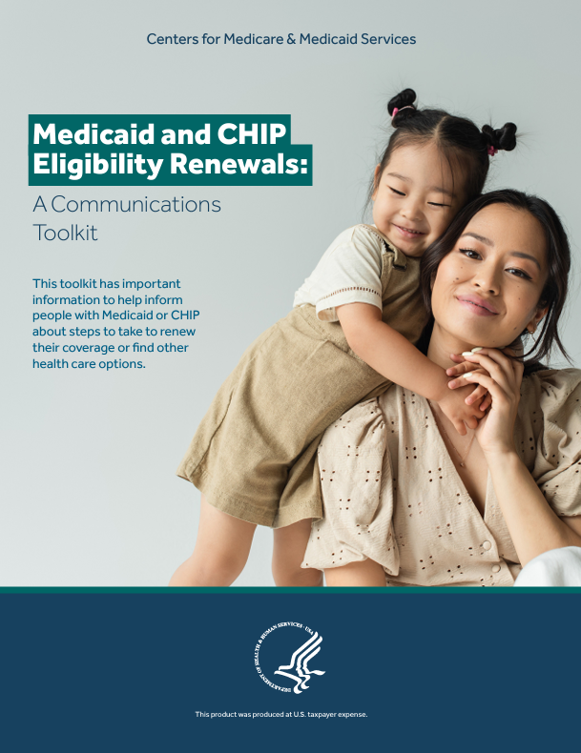
Medicaid and CHIP Continuous Eligibility Renewals: A Communications Toolkit
A living resource where products will be added/updated as we learn
more about what states, partners and consumers need to respond to
Contains important information to help inform people with Medicaid or CHIP
about steps they need to take to renew their coverage or transition to another
health coverage option if no longer eligible for Medicaid or CHIP
Contents include:
- Overview
- Summary of research with key insights
Key messages
Fillable digital flyers:
- Drop in articles
- Social media and outreach products
- Emails
- SMS/text messages
Call Center scripts
CMS Partner Tip Sheet
Factsheets
Available in English and Spanish. Select resources available in Chinese, Hindi, Korean, Tagalog, and Vietnamese.
Notes:
Talking Points for This Slide:
CMS has created a series of resources to help partners become more informed about Medicaid Unwinding and to help support partners as they prepare and reach out to their audiences.
On Medicaid.gov/unwinding, you can find our Unwinding Communications Toolkit and graphics. The toolkit provides some additional context on Unwinding that we hope will be helpful if you and your colleagues are new to the topic of Unwinding or if you are working with people that need a basic understanding of Unwinding.
There are also some key messages derived from consumer research that we think will resonate well, are the most understandable, and will help consumers take action.
These messages are woven into a variety of resources in the toolkit to help meet people where they are with options that will allow our partners to integrate them into their usual lines of communication with their audiences. Updated messages and materials will be added to this toolkit.
Right now the full toolkit is available in English and Spanish. Select resources are available in Chinese, Hindi, Korean, Tagalog, and Vietnamese as well.
Additional Talking Points
I want to highlight our Unwinding Communications Toolkit that we released in March 2022 and continue to be updated with new messaging and materials. This is a living document that we will continue to add to over time.
The resources in the Communications Toolkit can be used by your organization starting today to help spread information with your networks as well as learn more about Unwinding and the kind of messaging that we suggest during Phase One.
In addition to the same materials and messaging, we have also added some context that we hope will be helpful if you and your colleagues are new to the topic of Unwinding or if you are working with people that need a basic understanding of Unwinding.
We have included some information on the research that we did with beneficiaries who are likely to be impacted for some added context on why we suggest the provided messaging and types of resources shared in the toolkit.
The CMS Office of Communications also conducted consumer research to inform Unwinding Outreach related to message to promote the use of HealthCare.gov. That research can be found with the toolkit on Medicaid.gov/unwinding.
In the toolkit, you will find some key messages derived from those recommendations from our consumer research. These are the messages that we think will resonate most, are the most understandable, and will help beneficiaries take action.
These messages are woven into a variety of resources in the toolkit to help meet people where they are with options that will allow our partners to integrate them into their usual lines of communication with their audiences.
There are fillable flyers where partners can fill in individual state or local resources on top of the general messaging.
We have also included a drop-in article, social media posts and graphics, text messages and email content, and a call-center script if you are taking live calls from beneficiaries.
The toolkit also includes a new Tip Sheet for partners to people who have lost Medicaid or CHIP coverage.
So far, the Communications Toolkit is available in English and Spanish. Select resources are available in Chinese, Hindi, Korean, Tagalog, and Vietnamese.
As I mentioned, this is a living document, and we will continue to add new resources.

Slide 13
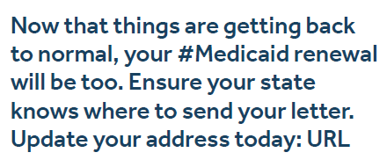
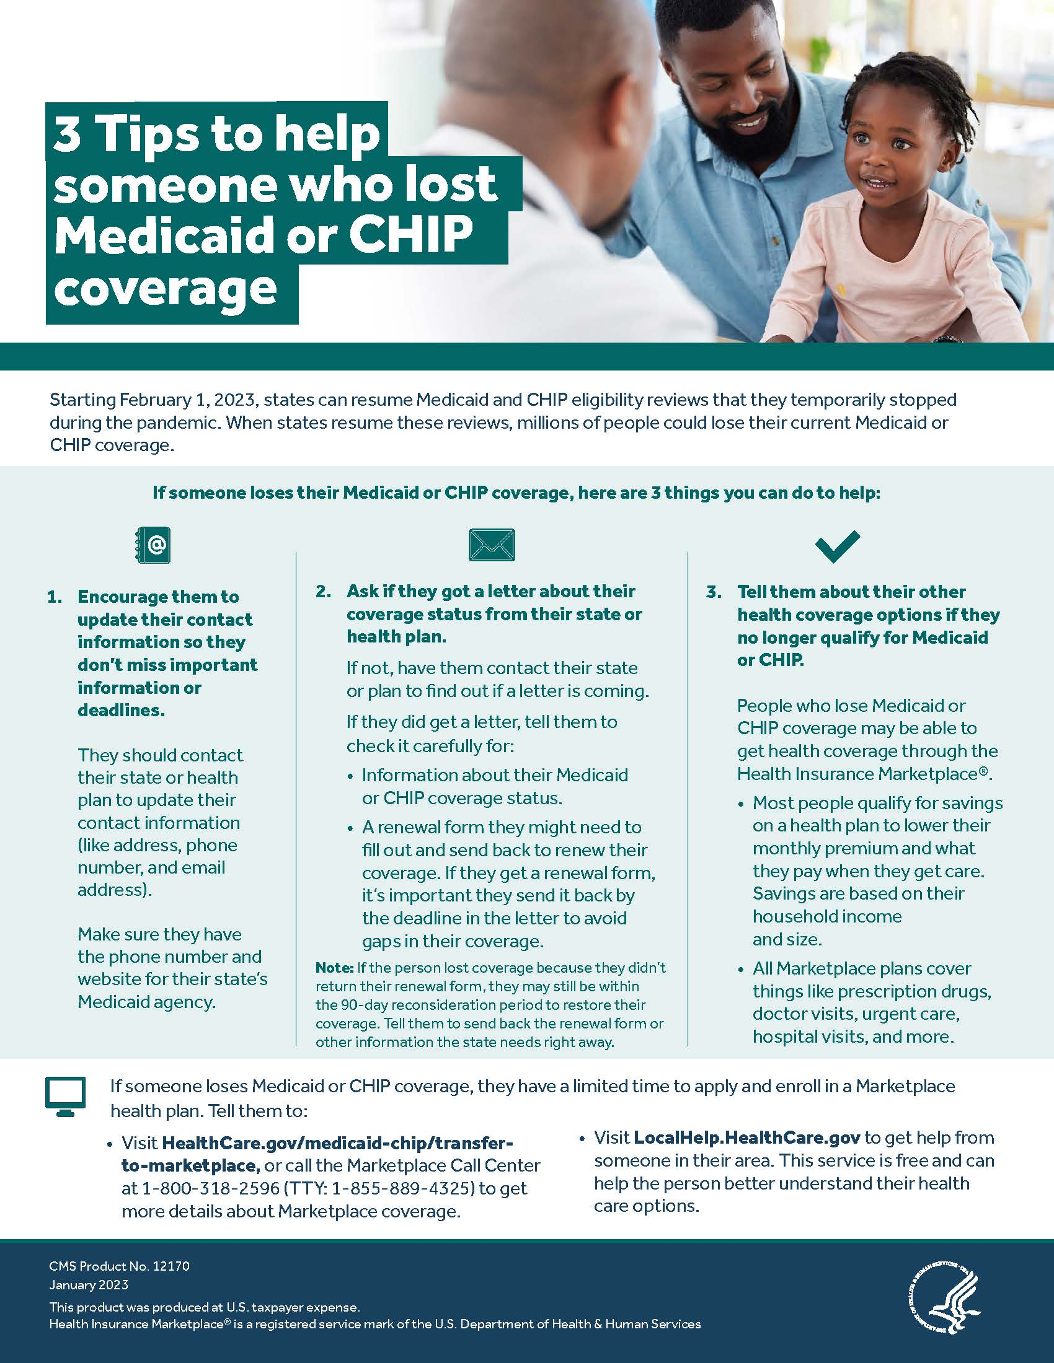
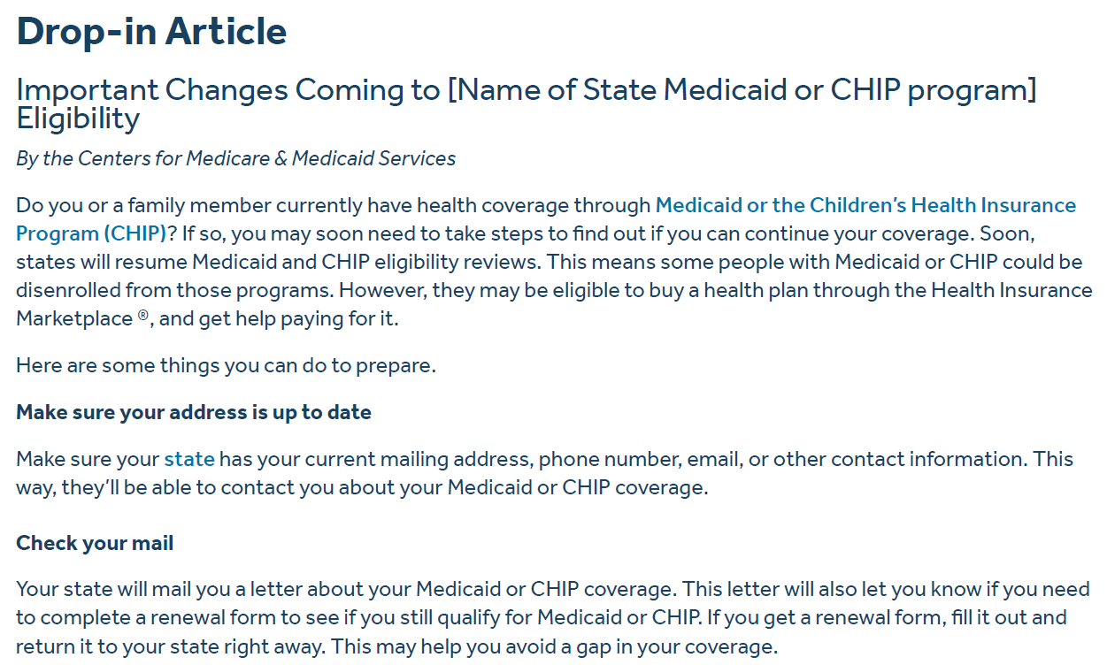
Sample Communications Toolkit Materials
Text Messages
Social Media Graphics
Partner Tip Sheet
Drop-in Article
Notes:
Talking Points for This Slide:
Examples of tools available include:
A drop-in article, social media posts and graphics, text messages and email content, and a call-center script if you are taking live calls from consumers.
There is also the Partner Tip Sheet that I mentioned with tips to help some who lost Medicaid or CHIP coverage.
In addition, there are fillable flyers where partners can fill in individual state or local resources on top of the general messaging.

Slide 14
Call to Action and Key Messages for Partners
CMS Needs Your Help!
What Partners Can Do NOW
Right now, partners can help prepare for the renewal process and educate Medicaid and CHIP enrollees about the recent changes. This includes making sure that enrollees have updated their contact information with their State Medicaid or CHIP program and are aware that they need to act when they receive a letter from their state about completing a renewal form.
Key Messages for Partners to Share
There are three main messages that partners should focus on now when communicating with people that are enrolled in Medicaid and CHIP.
Update your contact information – Make sure [Name of State Medicaid or CHIP program] has your current mailing address, phone number, email, or other contact information. This way, they’ll be able to contact you about your Medicaid or CHIP coverage.
Check your mail – [Name of State Medicaid or CHIP program] will mail you a letter about your Medicaid or CHIP coverage. This letter will also let you know if you need to complete a renewal form to see if you still qualify for Medicaid or CHIP.
Complete your renewal form (if you get one) – Fill out the form and return it to [Name of State Medicaid or CHIP program] right away to help avoid a gap in your Medicaid or CHIP coverage.
Sample social media posts, graphics, and drop-in articles that focus on these key messages can be found in the Communications Toolkit. The Unwinding resource page will continue to be updated as new resources and tools are released.
Resources for Phase II have been added to the toolkit and include messages to help ensure Medicaid and CHIP enrollees take the necessary steps to renew coverage, or transition to other coverage if they’re no longer eligible for Medicaid or CHIP.
Notes:
Talking Points for This Slide:
Right now, partners should think about what their organization can do in the coming weeks and months to really commit to this work.
We encourage you to think about how your organization may be helpful and how you may be able to connect with other organizations in your state, region and/or community to reach people with Medicaid and CHIP coverage.
We also encourage you to use the Toolkit resources we discussed, and begin incorporating information about Unwinding into materials, presentations, and workplans you have in development.
Lastly, we encourage you all to attend HHS and CMS’s monthly Medicaid and CHIP Continuous Enrollment Unwinding Webinar Series on the fourth Wednesday of every month at 12:00 p.m. ET.
Additional Talking Points
Call to Action
Right now, there are four things that you and your organization can do in the weeks and months ahead to really commit yourself to this work.
First, commit to making Unwinding work a priority for your organization, as well as the coalitions and other people that you work with. We want you to think about how your organization might be helpful in this work and what your strengths are.
Second, connect with other organizations in your state, region, and/or community that work with Medicaid and CHIP beneficiaries. Also think about organizations that might not consider themselves Medicaid experts, such as food banks who work with a lot of people that likely have Medicaid and CHIP.
Third, attend our Medicaid and CHIP Continuous Enrollment Unwinding partner education webinar series. This is a monthly series where we cover different topics related to Unwinding. We ask that you join these webinars and invite your colleagues and partners to join as well.
Fourth, incorporate information about Unwinding into materials, presentations, and workplans you have in development. CMS’s Unwinding Communications Toolkit has a lot of great resources and language that you can adapt to fit the needs of your organization and the audiences you reach.
We appreciate your partnership in helping to make sure that people remain connected to health coverage, and we are here to support our partners anyway that we can throughout the Unwinding process.

Slide 15
Medicaid Unwinding Special Enrollment Period (SEP)
To ensure individuals have sufficient time to enroll in Marketplace coverage during the unwinding period, consumers who lose Medicaid/CHIP coverage between March 31, 2023 and July 31, 2024 will be eligible for a 60-day SEP beginning the day they submit or update a Marketplace application.
Consumers can access this Unwinding SEP by submitting or updating an application through HealthCare.gov, a certified partner that supports SEPs, or the Marketplace Call Center.
CMS has published Marketplace guidance on the unwinding SEP: https://www.cms.gov/technical-assistance-resources/temp-sep-unwinding-faq.pdf
CMS recommends that Medicaid/CHIP enrollees submit or update an application on HealthCare.gov as soon as they receive their Medicaid/CHIP termination letter from their state.
More information can be found at: https://www.healthcare.gov/medicaid-chip/transfer-to-marketplace/
Notes:
Talking Points for This Slide:
Now onto a little more detail on Marketplace enrollment.
First, I want to note that anyone can apply for federal Marketplace coverage during Open Enrollment, which occurs annually from November 1st – January 15th.
Outside of Open Enrollment, individuals may qualify for a Special Enrollment Period (SEP) if they experience a qualifying life event, such as losing their health coverage.
To ensure consumers have sufficient time to enroll in Marketplace coverage during the unwinding period, consumers who lose Medicaid/CHIP coverage between March 31, 2023 and July 31, 2024 will be eligible for a 60-day SEP beginning the day they submit or update a Marketplace application
Consumers can access the Unwinding SEP by submitting or updating an application through HealthCare.gov, a certified partner that supports SEPs, or the Marketplace Call Center.
Consumers who are determined eligible for this Unwinding SEP will have 60 days from the date on which they submit a new or updated HealthCare.gov application to make a plan selection.
If anyone has questions on this SEP, we recommend reviewing the FAQs linked here.
CMS recommends that Medicaid/CHIP beneficiaries submit or update an application on HealthCare.gov as soon as they receive their Medicaid/CHIP termination letter from their state. Individuals do not need to wait to receive the a notice from the Marketplace to apply for coverage.

Slide 16
How to Get Help Applying for Marketplace Coverage
If individuals need help completing a Marketplace application, they can:
Visit HealthCare.gov
HealthCare.gov will direct individuals to their state-based Marketplace, as applicable
Call the Marketplace Call Center at 1-800-318-2596 (TTY: 1-855-889-4325)
Visit https://localhelp.healthcare.gov/ to make an appointment with someone in their area who can help
Notes:
Talking Points for This Slide:
In summary, I want to highlight how individuals can get help completing a Marketplace application. They can:
Visit HealthCare.gov
HealthCare.gov will direct individuals to their state-based Marketplace website, as applicable
Call the Marketplace Call Center at 1-800-318-2596
Visit localhelp.healthcare.gov to make an appointment with someone in their area who can help

Slide 17
South Carolina Statewide Navigator
South Carolina Primary Health Care Association
Assister - 9th year of service on the Marketplace
Phone: (803) 788 - 2778
Email: information@scphca.org
Website: http://scphca.org/

Slide 18
Contact Information
Rhonda Hunter
The Atlanta Federal Center
The Centers for Medicare & Medicaid Services
61 Forsyth Street, Suite 4-T-20
Atlanta, Georgia 30303
Rhonda.hunter@cms.hhs.gov
404-562-7217

